Slide 1
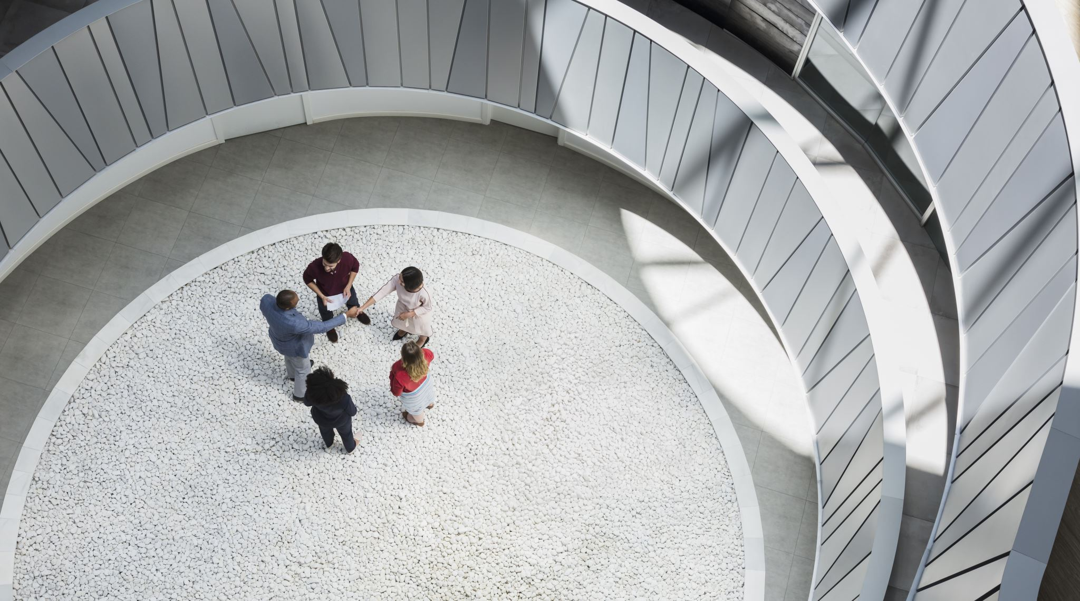
Research Report
Research Report
BY CHANA ROGER

Slide 2
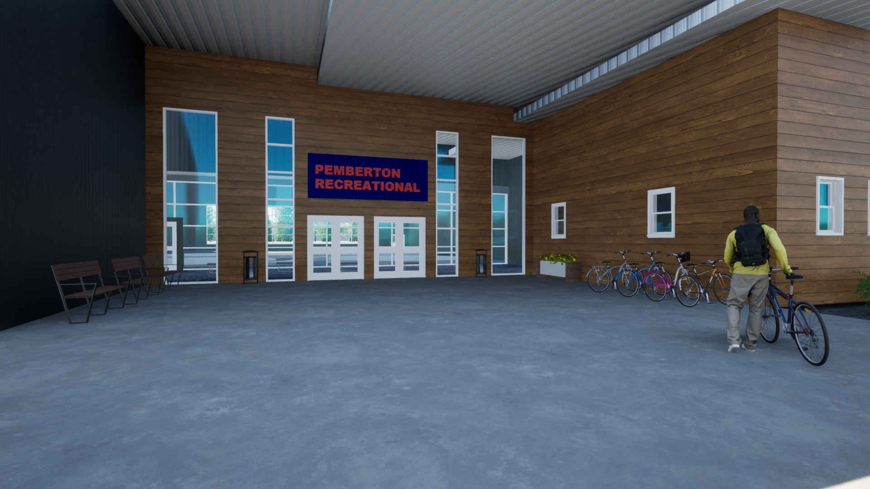
The Preliminary Design of a Recreation Centre
The Preliminary Design of a Recreation Centre
“Universal design is the design of an environment so that it can be understood, accessed and used to the greatest extent possible by all people regardless of their age or ability.”
-Centre for Excellence in Universal Design
https://www.google.com/search?q=universal+design&rlz=1C1CHBF_enCA869CA869&sxsrf=AOaemvKhF5uANL86oyRyIDx1DBADggi3ug:1637442250689&source=lnms&tbm=isch&sa=X&ved=2ahUKEwimw8Td66f0AhX0oFsKHR3iD6MQ_AUoAXoECAEQAw&biw=1536&bih=754&dpr=1.25#imgrc=xzE3c6T6IM51dM

Slide 3
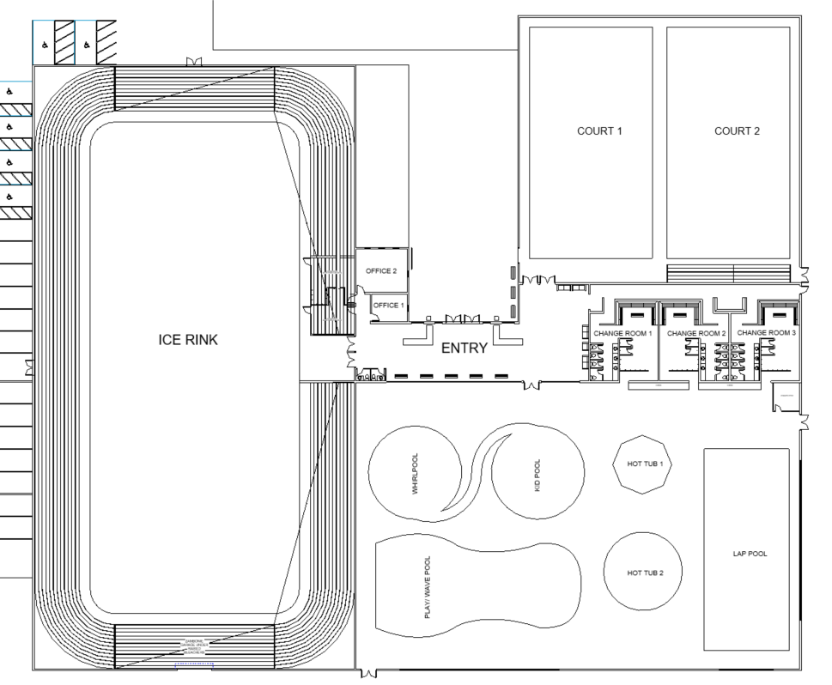
Floor Plan
Single storey for ground level accessibility.
No elevator required.

Slide 6
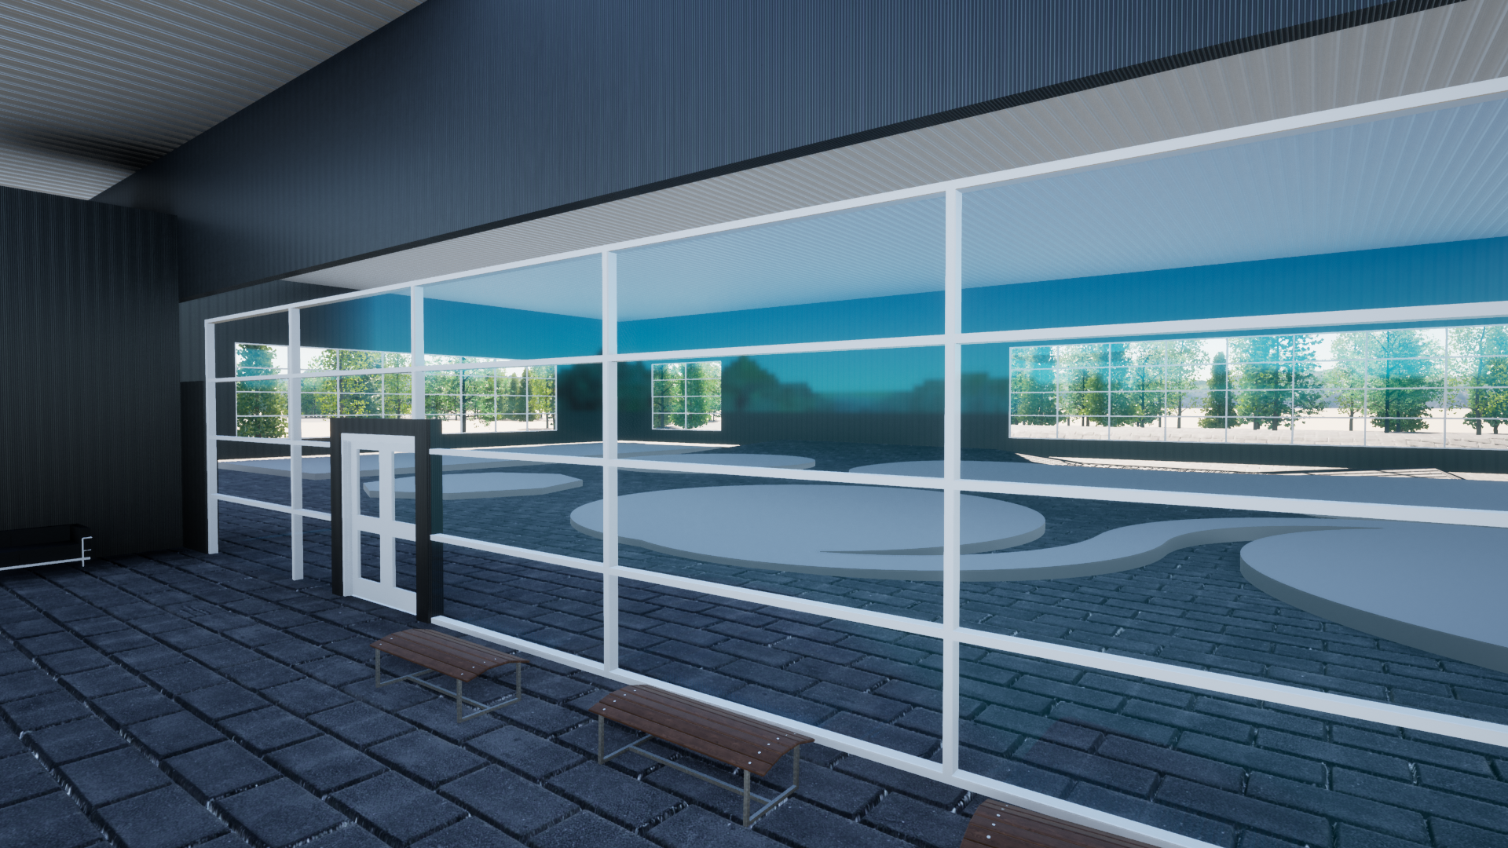
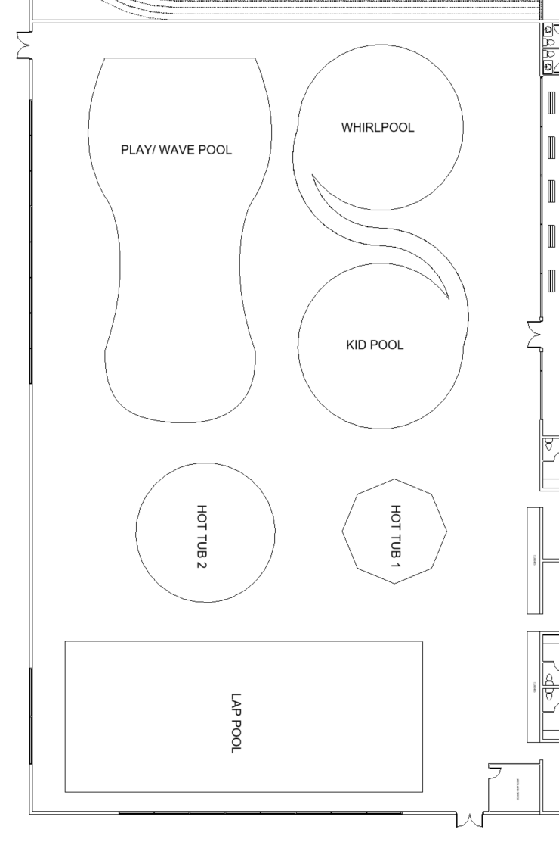
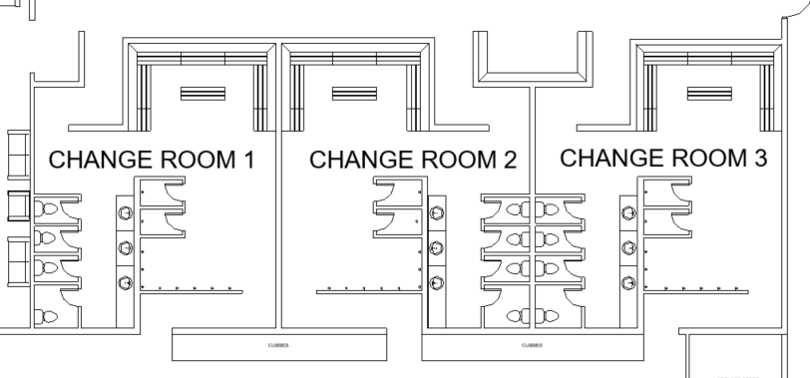

Slide 7
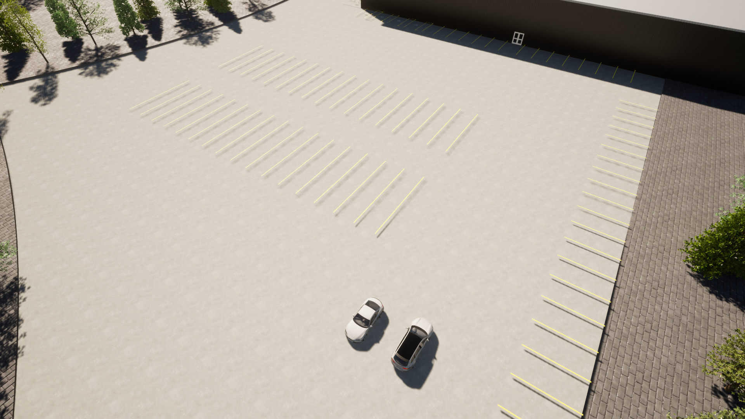
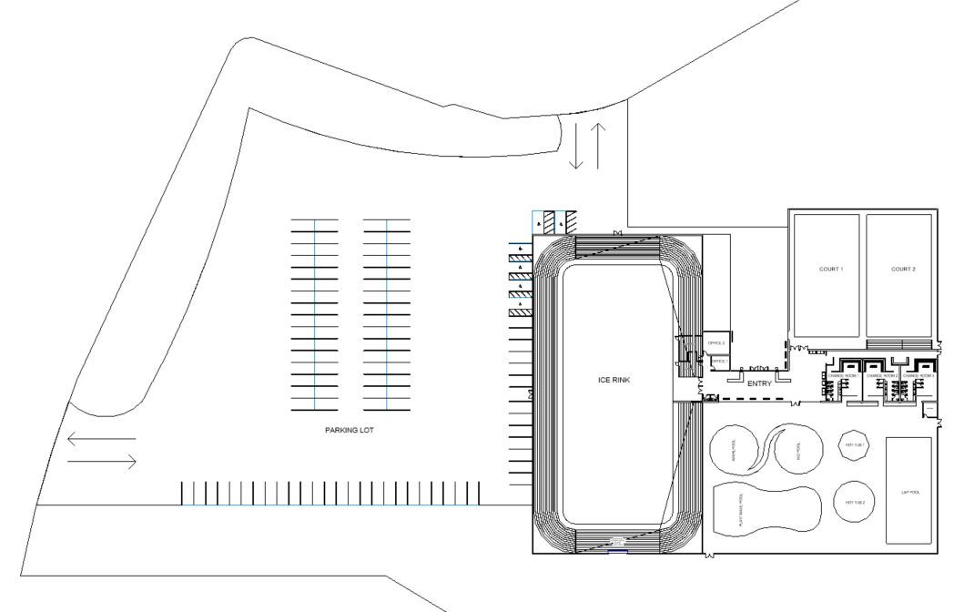

Slide 8
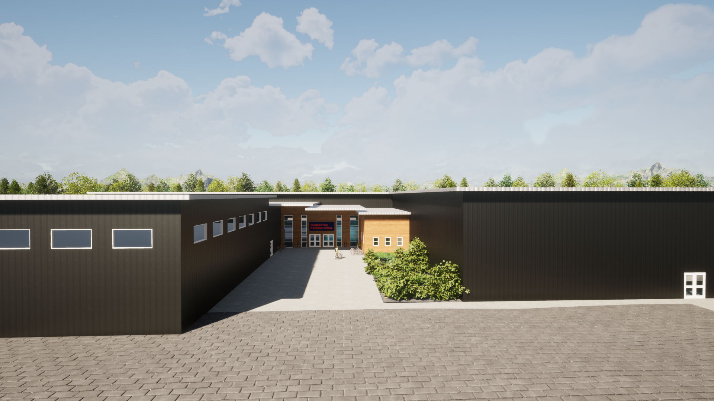
Thank you :)
Thank you :)

